Slide 1
Hands-on Deep Learning with Keras and Tensorflow
Seasonal School on
Efficient Circuits and Systems for Brain-Inspired Computing
8-9th September 2022
Prof. Luis A. Hernández Gómez
luisalfoso.hernandez@upm.es

Slide 2
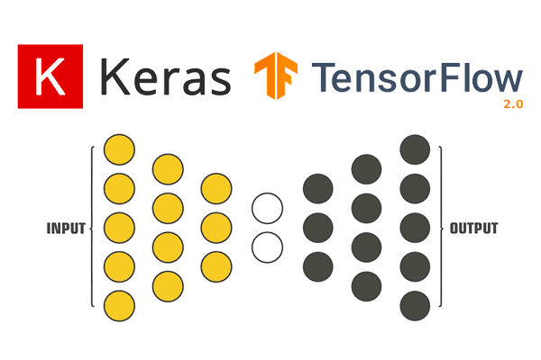
Seasonal School on
Efficient Circuits and Systems for Brain-Inspired Computing
8-9th September 2022
Hands-on Deep Learning with Keras and Tensorflow
Objective:
In this workshop you will learn to develop Deep Learning models using Keras on top of Tensorflow.
Image source:
https://pyimagesearch.com/2019/10/21/keras-vs-tf-keras-whats-the-difference-in-tensorflow-2-0/

Slide 3



Working Environment

Slide 4

https://www.python.org/
Python is a high-level, interpreted, general-purpose programming language.
Its design philosophy emphasizes code readability with the use of significant indentation.
Python was created in the early 1990s by Guido van Rossum at Stichting Mathematisch Centrum in the Netherlands
Kuhlman, Dave. "A Python Book: Beginning Python, Advanced Python, and Python Exercises". Section 1.1. Archived from the original (PDF) on 23 June 2012.

Slide 5

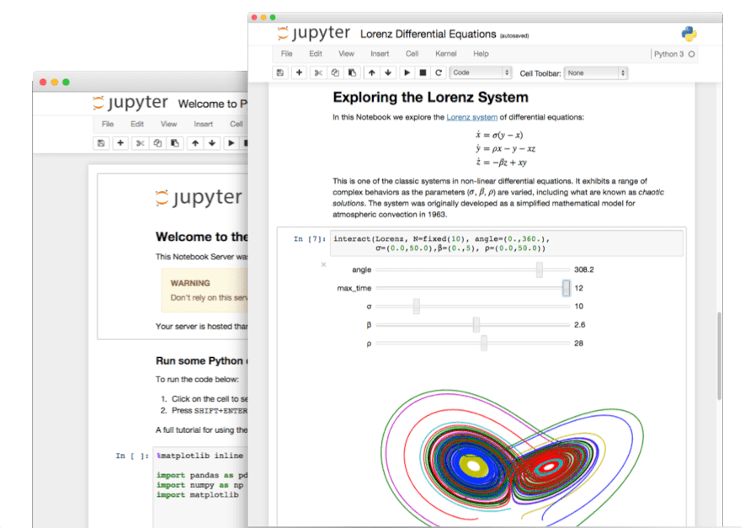
https://jupyter.org/
Jupyter Notebook:
The Classic Notebook Interface
The Jupyter Notebook is the original web application for creating and sharing computational documents. It offers a simple, streamlined, document-centric experience.

Slide 6
In this workshop we will use:
Python
… in Google
Colaboratory Notebooks
… that you can be saved in your
Google Drive
https://colab.research.google.com/
Image source:
https://gjuantorena.medium.com/como-empezar-a-analizar-datos-con-python-usando-google-colab-1e3cf68cba

Slide 7
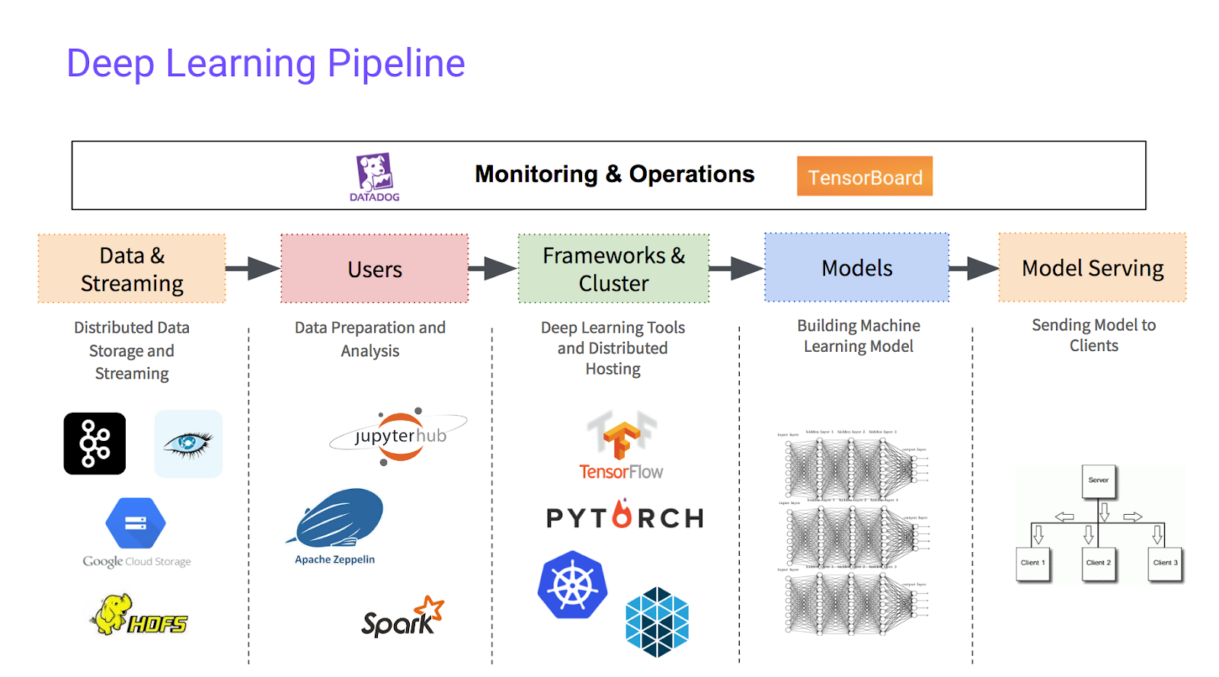
Image source:
https://www.visitmontanejos.com/en/agenda/action~oneday/exact_date~27-3-2023/?id=6.28.4130218.3.22.43.c%2B%2B+machine+learning+framework

Slide 8
In this workshop we will only introduce
… which is one of the leading high-level Deep Learning framework
Image source:
https://pyimagesearch.com/2019/10/21/keras-vs-tf-keras-whats-the-difference-in-tensorflow-2-0/

Slide 9
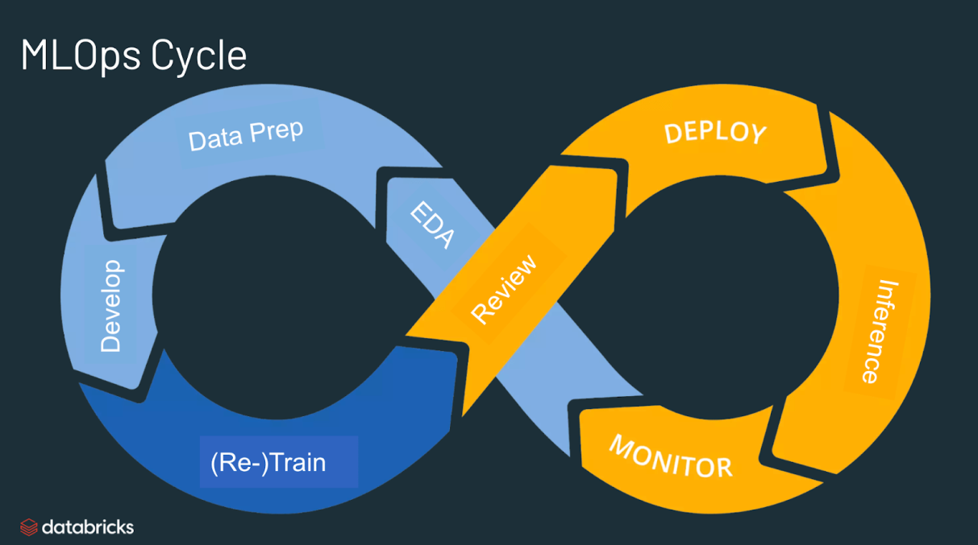
What do we call
high-level Deep Learning framework?
Define a Deep Learning Model
Train it
Test it
Deploy it
Image source:
https://databricks.com/it/glossary/mlops

Slide 10
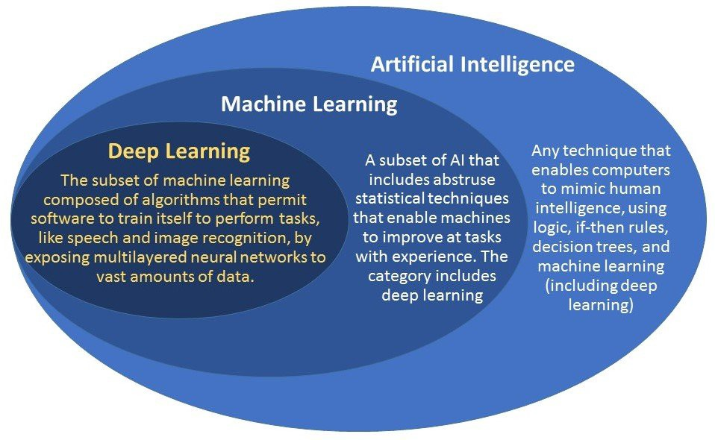

Slide 11
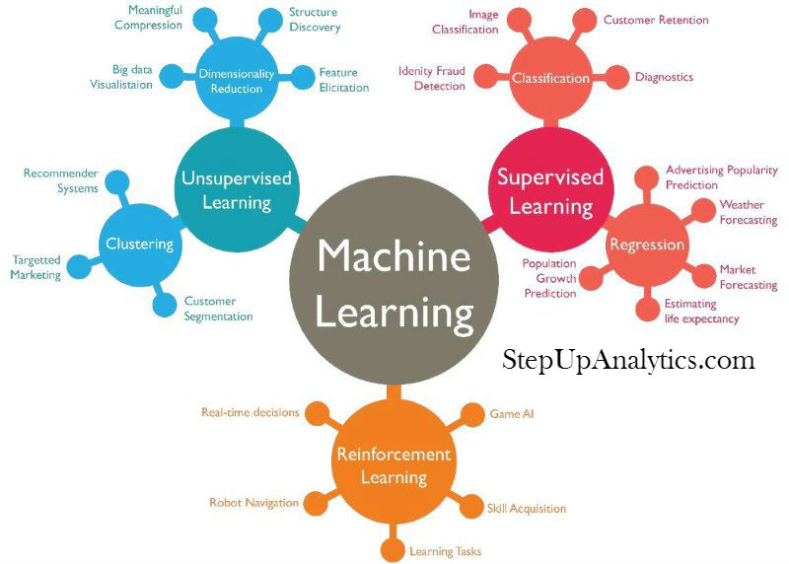

Slide 12
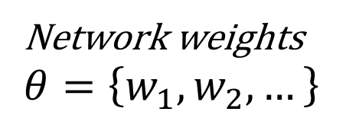
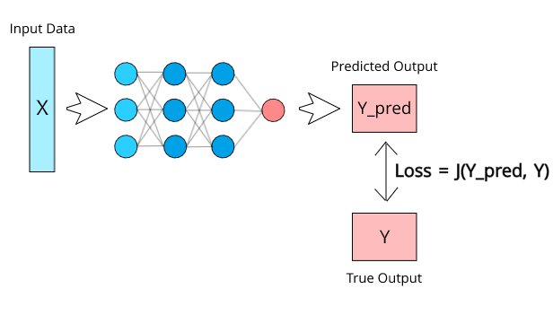
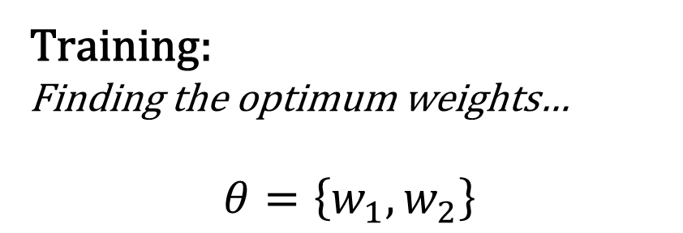
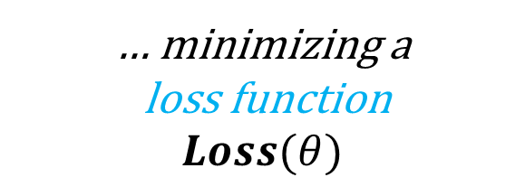
Supervised Learning

Slide 13
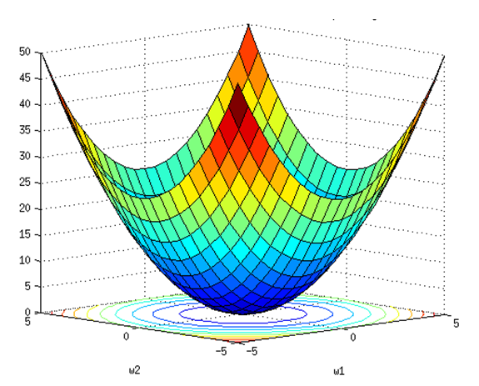
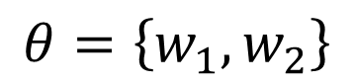
Gradient Descent
OPTIMIZATION
Loss(𝜃)
Loss function
Assume there are only two parameters w₁ and w₂ in a network and convex loss function
$$θ=\left\{w_{1},w_{2}\right\}$$

Slide 14
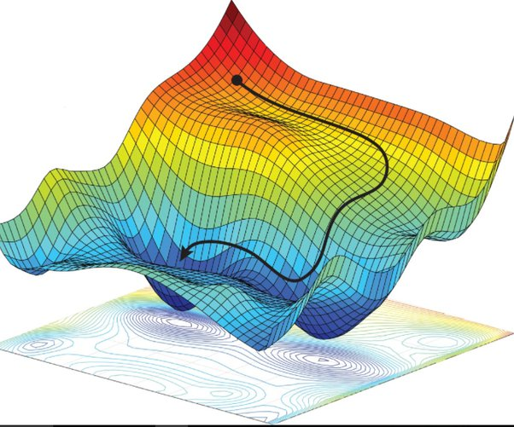
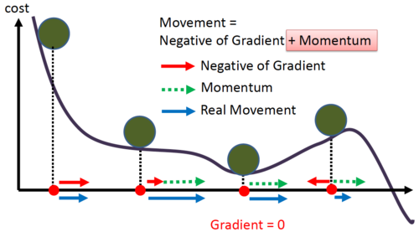
Image source:
https://medium.com/analytics-vidhya/momentum-rmsprop-and-adam-optimizer-5769721b4b19

Slide 15



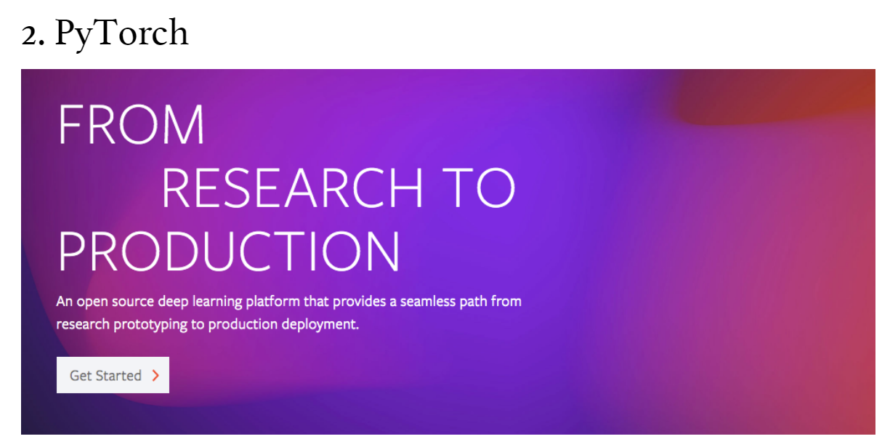

https://www.springboard.com/blog/data-science/deep-learning-frameworks/

Slide 16
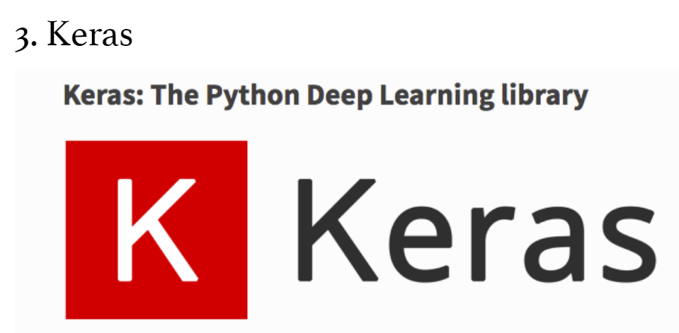
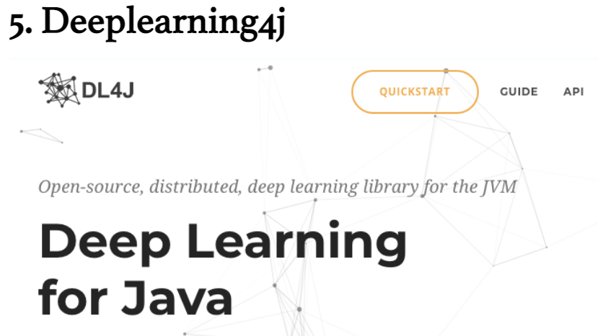
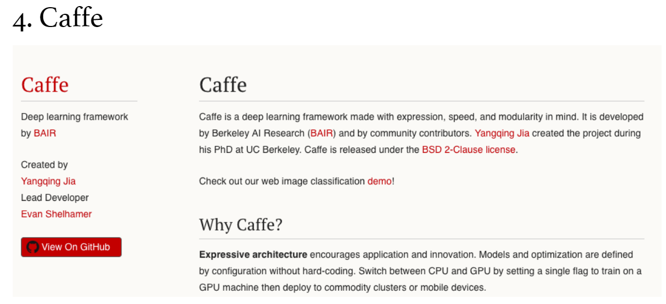
https://www.springboard.com/blog/data-science/deep-learning-frameworks/

Slide 17
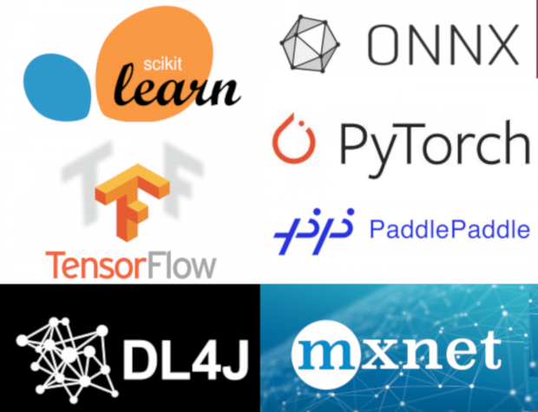


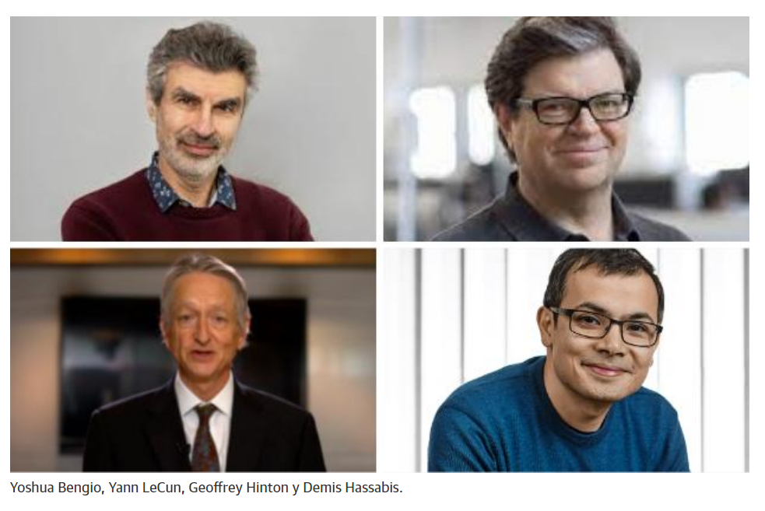

https://thenewstack.io/the-ultimate-guide-to-machine-learning-frameworks/

Slide 18
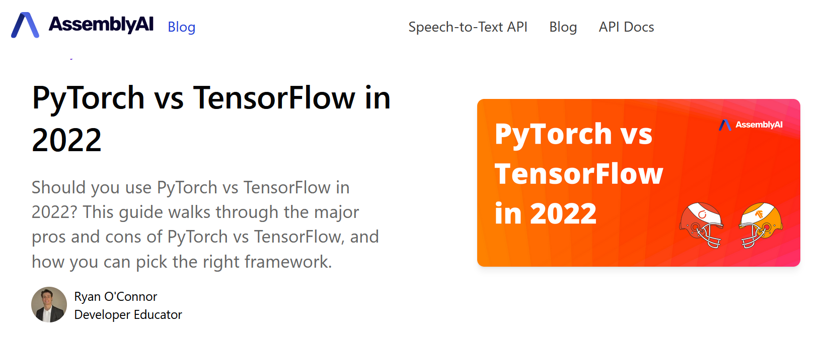
https://www.assemblyai.com/blog/pytorch-vs-tensorflow-in-2022/

Slide 19
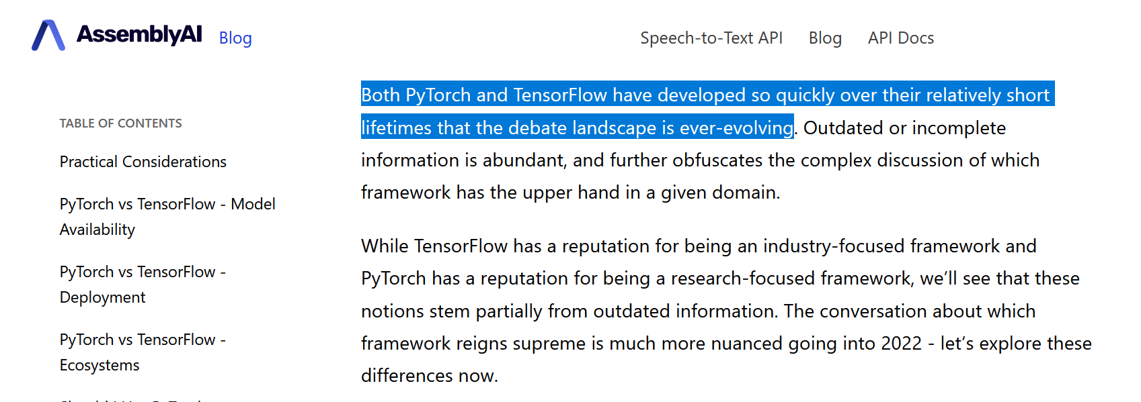
https://www.assemblyai.com/blog/pytorch-vs-tensorflow-in-2022/

Slide 20
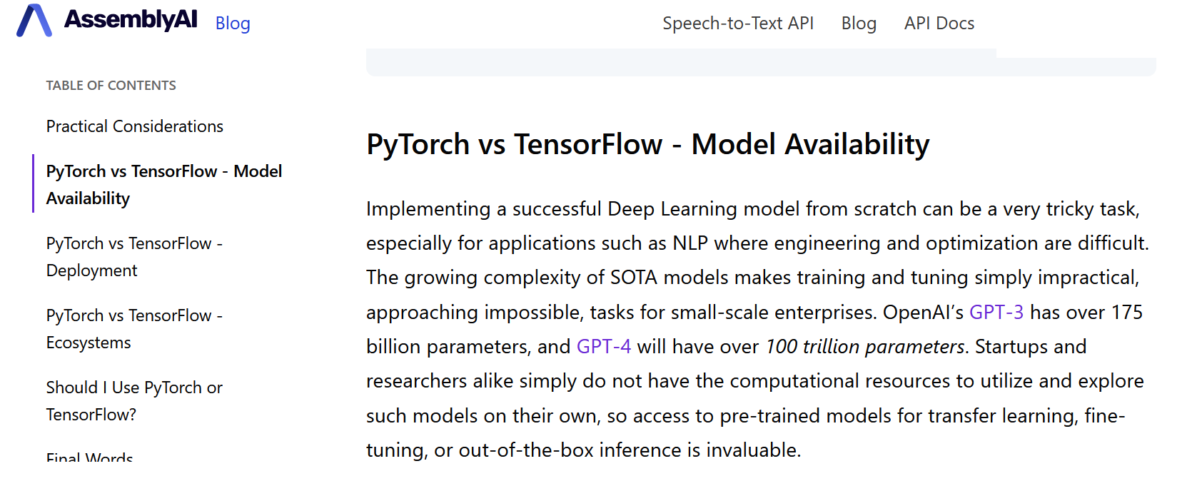
https://www.assemblyai.com/blog/pytorch-vs-tensorflow-in-2022/

Slide 21


Slide 22
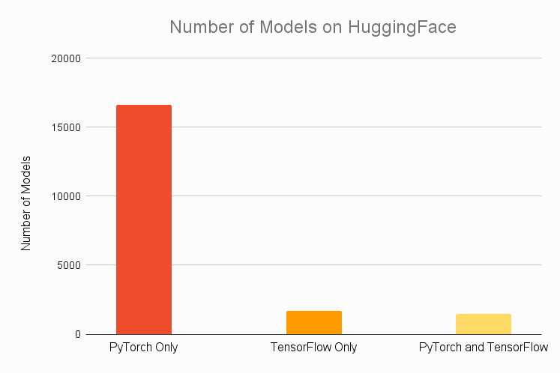
https://www.assemblyai.com/blog/pytorch-vs-tensorflow-in-2022/

Slide 23
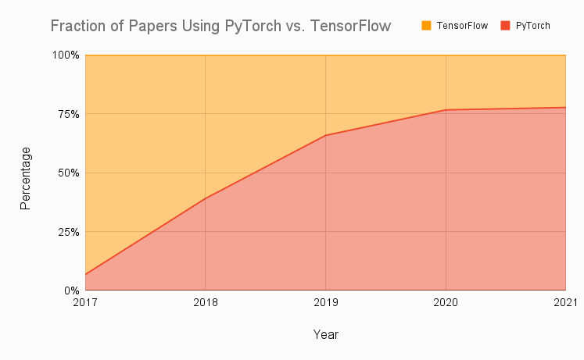
https://www.assemblyai.com/blog/pytorch-vs-tensorflow-in-2022/

Slide 24
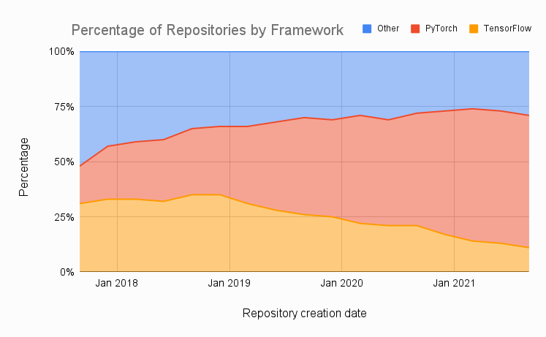
https://www.assemblyai.com/blog/pytorch-vs-tensorflow-in-2022/

Slide 25
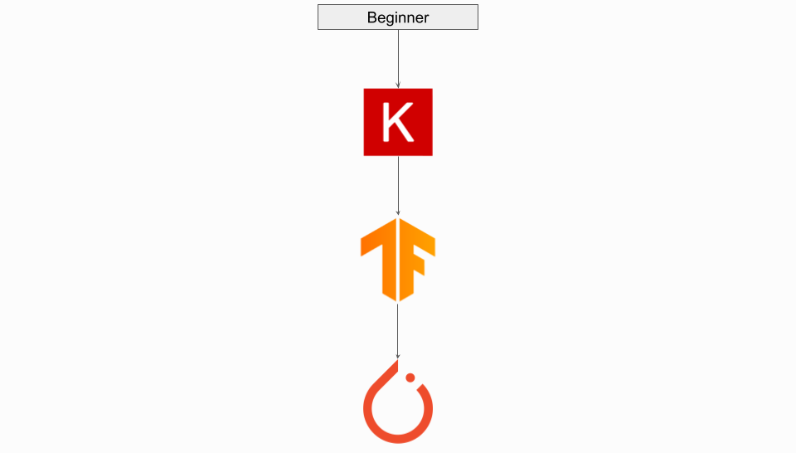

Slide 26
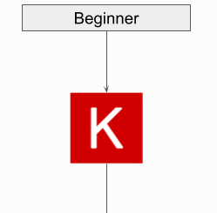
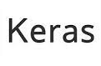

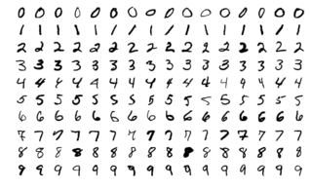
Now we will use:
For the classical MNIST image classification problem
Image source:
https://gjuantorena.medium.com/como-empezar-a-analizar-datos-con-python-usando-google-colab-1e3cf68cba

Slide 27
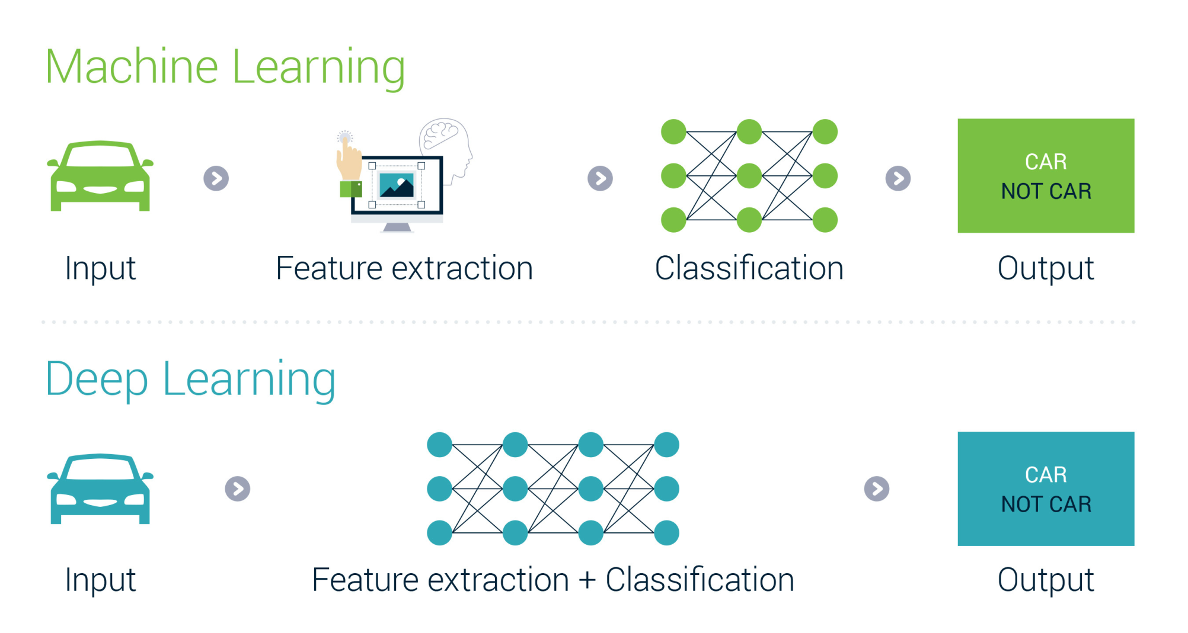
Image source:
https://ai.stackexchange.com/questions/16575/what-does-end-to-end-training-mean

Slide 28
You can run the Noebook:
IEEE_Seminar_MNIST_in_Keras.ipynb
directly in colab, following this link:
https://colab.research.google.com/github/MasterMSTC/IEEE-Summer-Seminar/blob/main/IEEE_Seminar_MNIST_in_Keras.ipynb

Slide 29
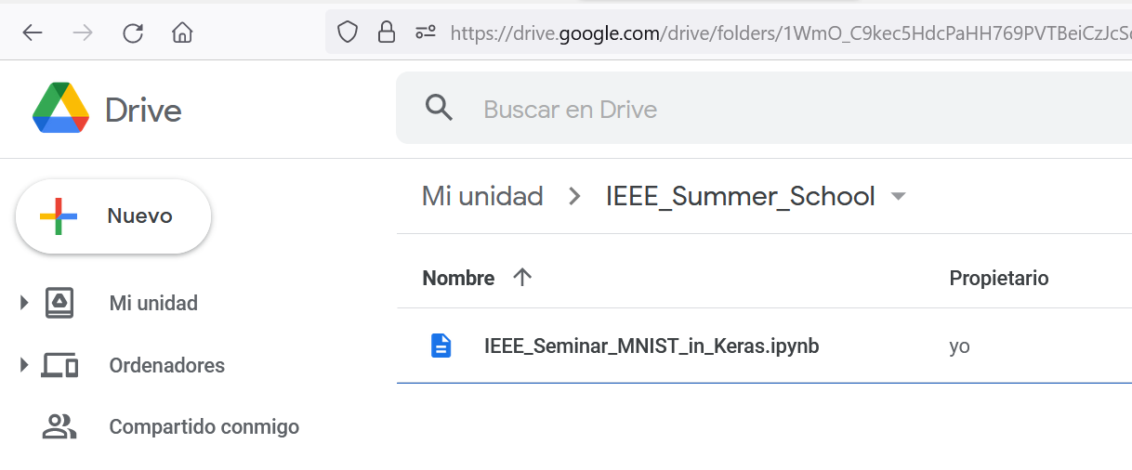
... or you can download the Notebook from GitHub:
https://github.com/MasterMSTC/IEEE-Summer-Seminar/blob/main/IEEE_Seminar_MNIST_in_Keras.ipynb
.... copy it into your Drive
.... and double-click and open with Colab

Slide 30
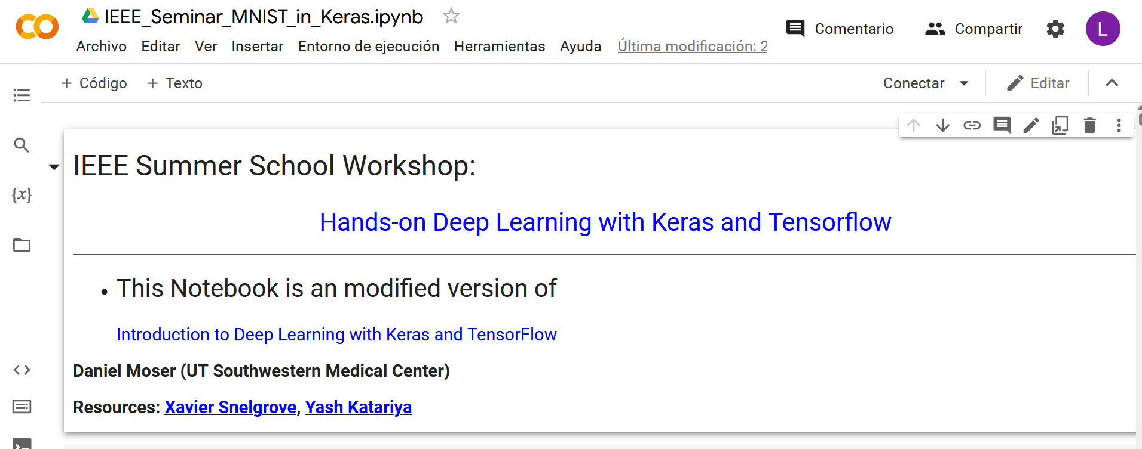

Slide 31
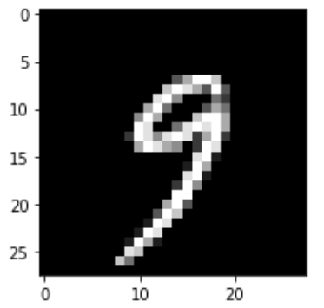

MNIST Image Classifier using
FeedForward Network
Output
Probabilities
x1
Hidden layer 1
Hidden layer 2
Output layer
y₁
0
0.1
0.4
1
Softmax
…
…
….…………
……
y₁₀
0.2
9
xN
Notes:
The same for even more complex tasks.

Slide 32
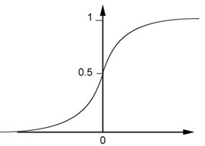
…
Activation function, as a Sigmoid function
weights
Sigmoid Function
bias

Slide 33
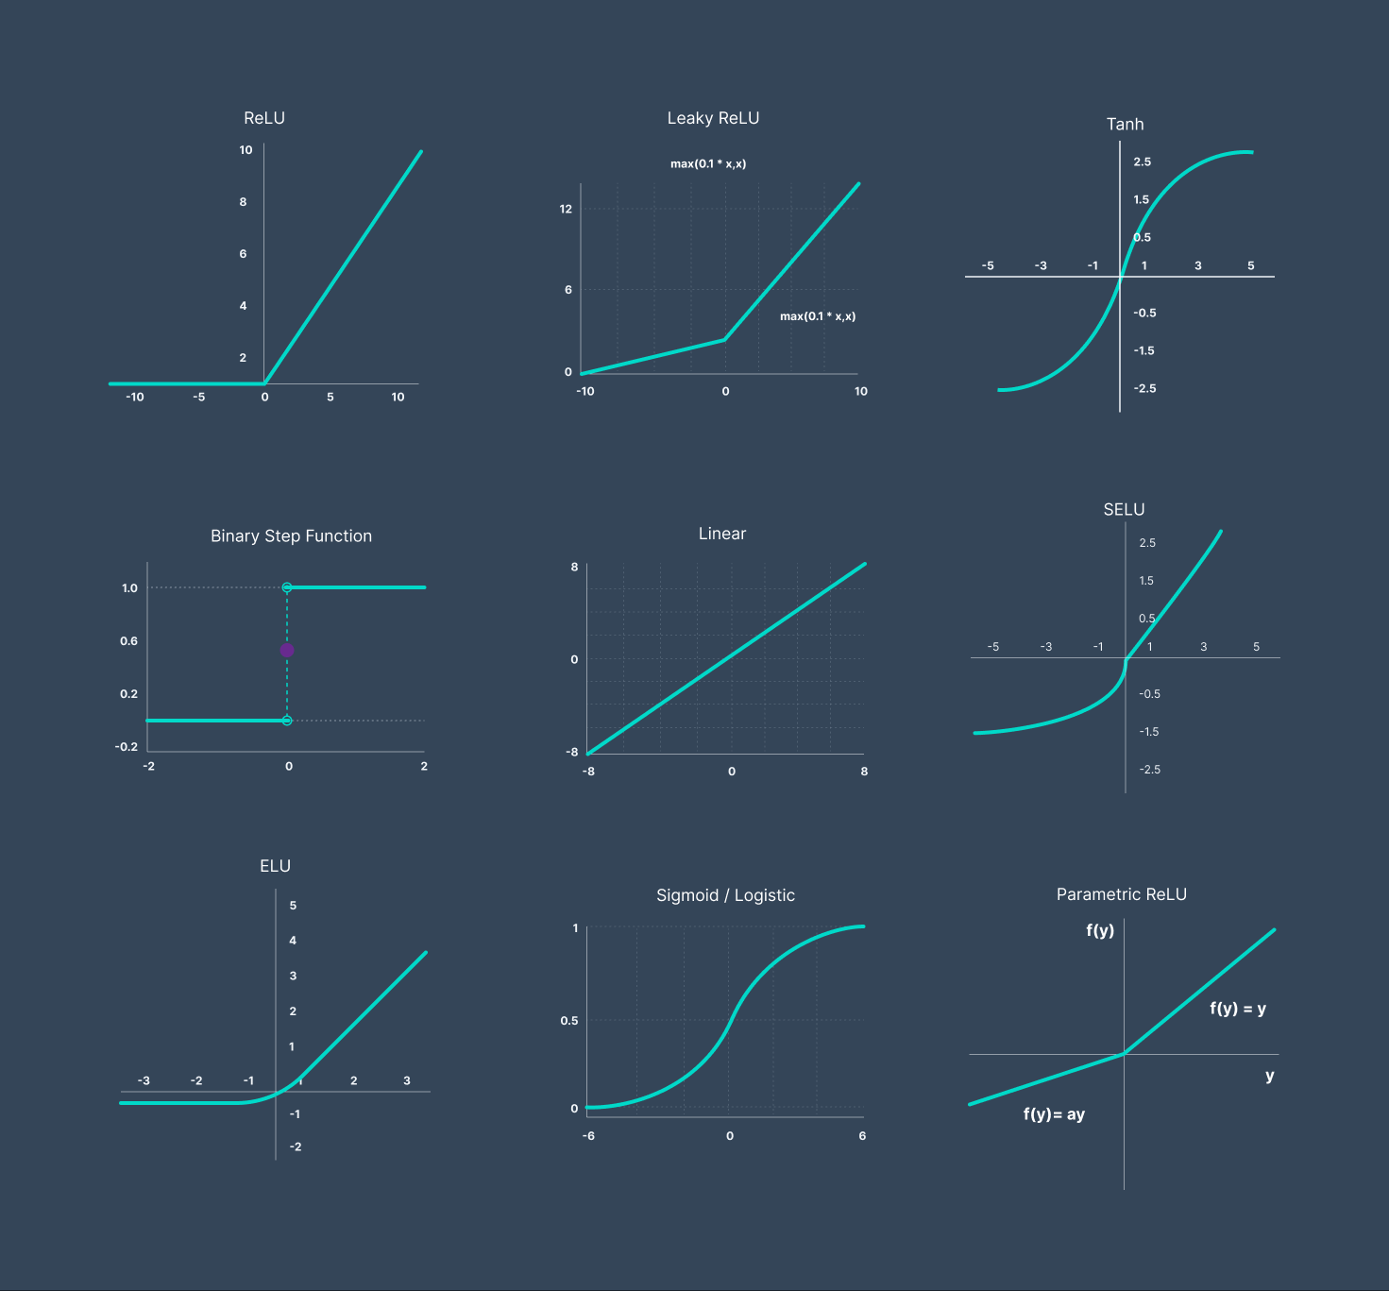
Image source:
https://www.v7labs.com/blog/neural-networks-activation-functions

Slide 34
Dropout
Training:
Each time before computing the gradients
Each neuron has p% to dropout
Notes:
Iteration v.s. epoch!!!!!!!!

Slide 35
Dropout
Training:
Thinner!
Each time before computing the gradients
Each neuron has p% to dropout
The structure of the network is changed.
Using the new network for training
For each mini-batch, we resample the dropout neurons
Notes:
Do not worry that someone will not update

Slide 36
Dropout is a kind of ensemble.
Testing of Dropout
testing data x
All the weights multiply (1-p)%
……
y₁
y₂
y₃
average
≈
y
Notes:
0,0 -> 0
1,0 -> 1
0,-1 -> -2
1,-1 -> -1
½, -1/2 -> -0.5
1,2
Geometric Mean?

Slide 37
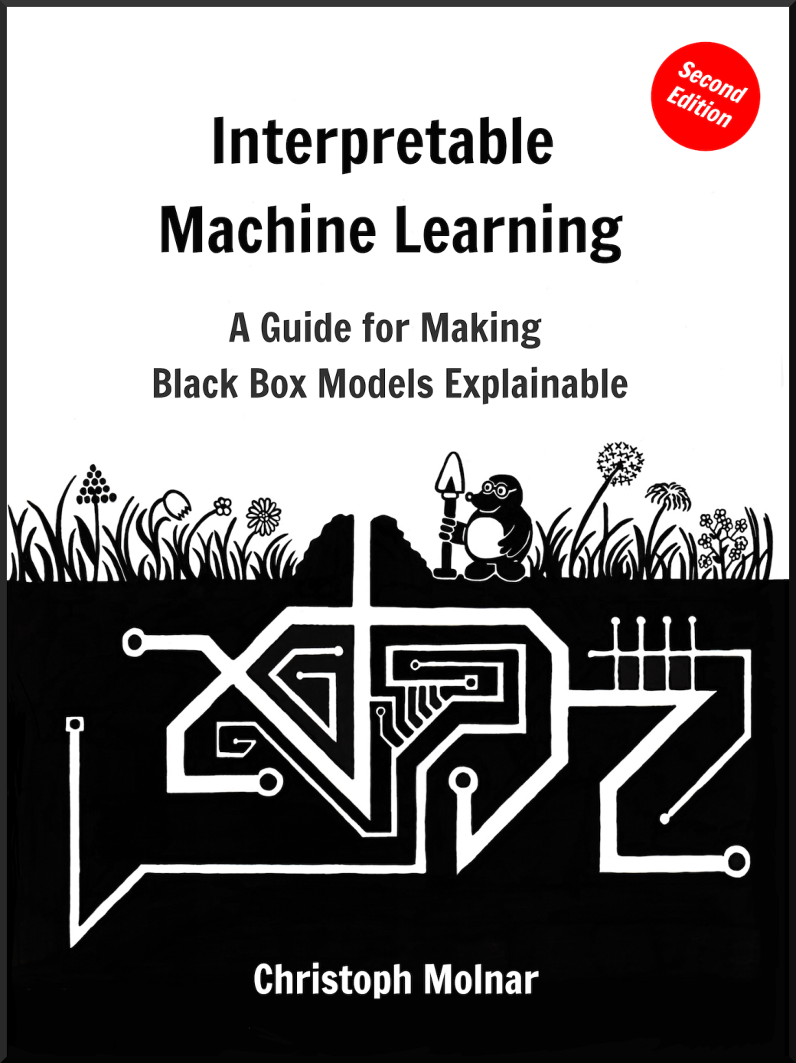
https://christophm.github.io/interpretable-ml-book/

Slide 38
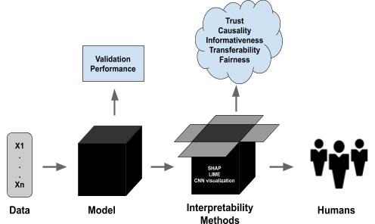
When and why do we want interpretability?
Interpretability is needed when model metrics are not enough
https://blog.ml.cmu.edu/2020/08/31/6-interpretability

Slide 39

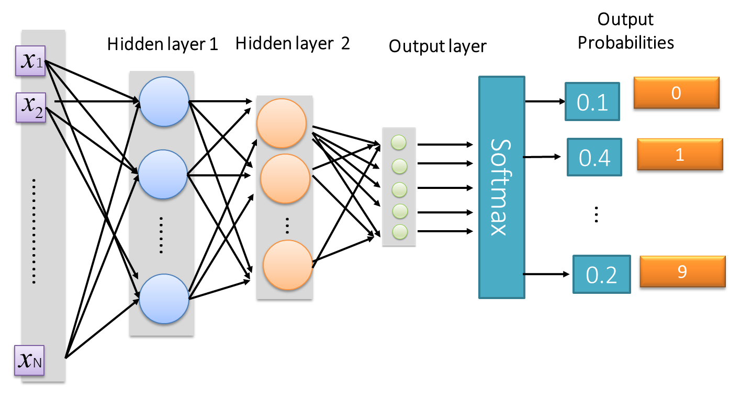
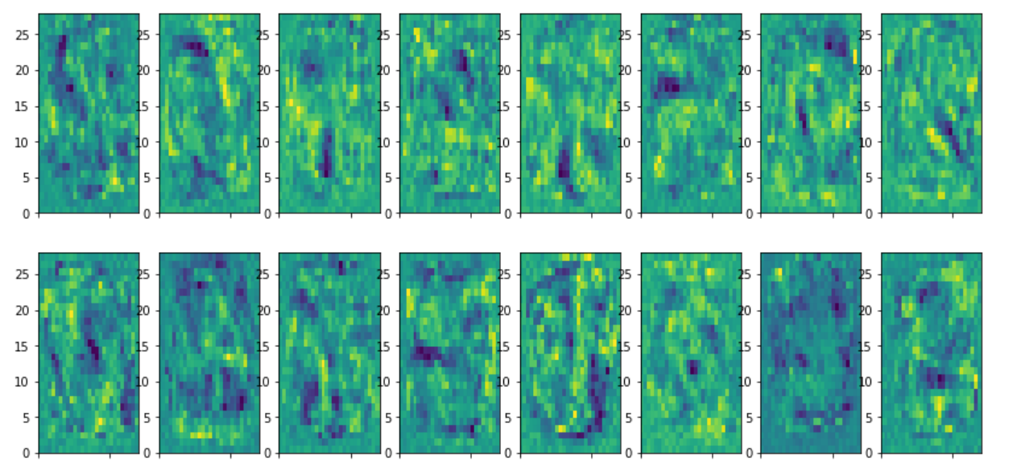
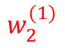
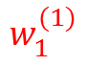
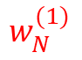



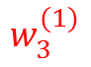
Simple way to INTERPRET the Feed Forward model:
Visualize the first hidden layer
$$w_{1}^{(1)}$$
$$w_{2}^{(1)}$$
$$w_{N}^{(1)}$$
$$w_{1}^{(1)}$$
$$w_{2}^{(1)}$$
$$w_{3}^{(1)}$$
……
$$w_{N}^{(1)}$$

Slide 40
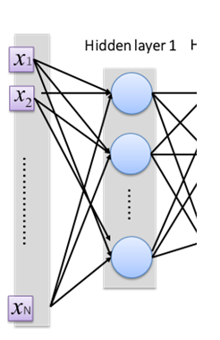
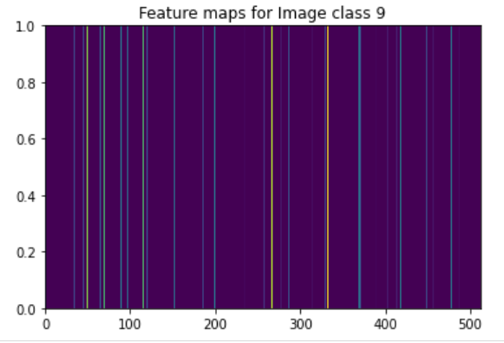
Simple ways to INTERPRET the Feed Forward model:
Visualize the output of hidden layers: feature maps

Slide 41

Convolutional Neural Networks: CNN
https://sefiks.com/2017/11/03/a-gentle-introduction-to-convolutional-neural-networks/

Slide 42


Slide 44

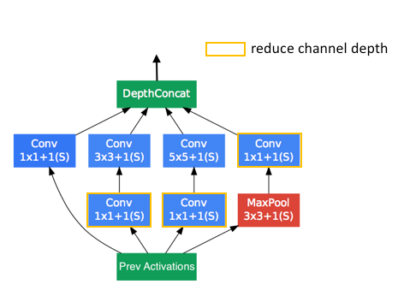
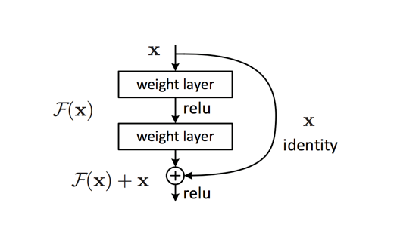
…there are many Convolutional Network Architectures
Common architectures in convolutional neural networks
https://www.jeremyjordan.me/convnet-architectures/
VGG (16)
ResNet (50) Inception-v3 (GoogLeNet)

Slide 45
Some relevant Deep Learning topics:
Data Augmentation
Transfer Learning

Slide 46
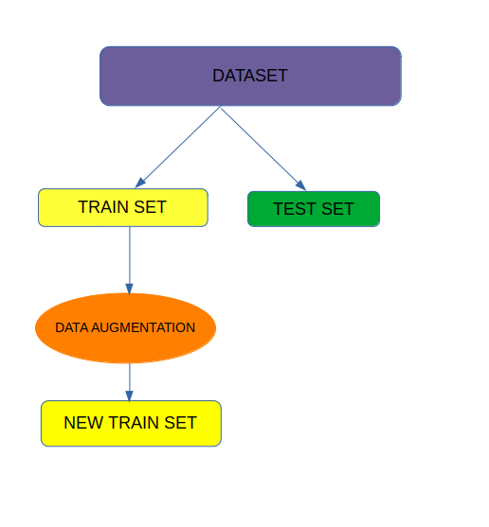
Data Augmentation

Slide 47
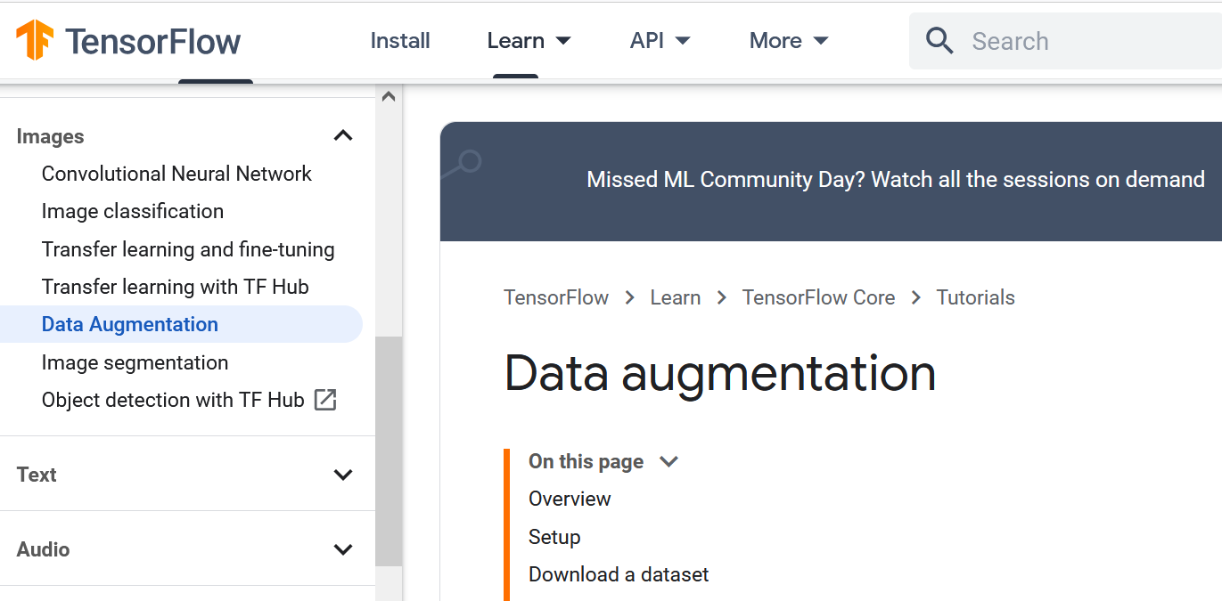

Slide 48

Data pre-processing and data augmentation
"augment" training data via a number of random transformations
This helps prevent overfitting and helps the model generalize better.

Slide 49

Data pre-processing and data augmentation

Slide 50
Transfer Learning

Slide 51

Building-powerful-image-classification-models-using-very-little-data Transfer Learning, Data Augmentation, ….
https://keras.io/guides/transfer_learning/

Slide 52

Image source:
El Houby, E. M. (2021). Using transfer learning for diabetic retinopathy stage classification.
Applied Computing and Informatics.

Slide 53
Recurrent Neural Networks
dealing with sequences of…

Slide 54
Sequences of …
Time Series: financial series, events, logs,…
Signals: speech, audio, images, video, sensors,…
Sequences of terms: words (natural language processing), notes (music)
Sequences of observations: actions, rewards: Reinforcement Learning (robots, bots, autonomous vehicles, dialog systems..)

Slide 55


Recurrent Neural Networks (RNNs)
RNNs combine the input vector with their state vector to produce a new state vector.
http://suriyadeepan.github.io/2017-02-13-unfolding-rnn-2/

Slide 56


…from a vector state we can generate an OUTPUT $y_{t}$

Slide 57

Recurrent Neural Networks (RNN) concepts
Emotion
Recognition
Language
Model
Image
description
using text
Seq2Seq:
Machine
Translation
Video frame
labelling
Phoneme
Recognition

Slide 58




In our MNIST example, each image is considered as a sequence of “pixel columns”
Recognized Digit
….
….

Slide 59


Core Idea Behind LSTM
CELL STATE $= c_{t}$
$$states= h_{t}$$

Slide 60

…you can see many examples at:
https://keras.io/examples/

Slide 61
…and there are many advanced topics you can learn about:
Attention and Transformers
Autoencoders, Generative Models, …
Self-supervised learning

Slide 62


Attention Mechanism

Slide 63
CS480/680 Lecture 19: Attention and Transformer Networks
https://www.youtube.com/watch?v=OyFJWRnt_AY

Slide 64


Transformer architecture
http://jalammar.github.io/illustrated-transformer/

Slide 65

https://github.com/lexfridman/mit-deep-learning/blob/master/tutorial_deep_learning_basics/deep_learning_basics.ipynb

Slide 66


Slide 67

Self-supervised learning
Using data without manual labels for powerful latent representations
Image source:
https://neptune.ai/blog/self-supervised-learning

Slide 68


Slide 70

There are a lot of amazing new ideas and challenges es
MULTIMODAL CORRESPONDENCE OF LATENT SPACES
https://openai.com/dall-e-2/

Slide 71
THANK YOU!
Luis A. Hernández Gómez
luisalfoso.hernandez@upm.es

